Slide 1
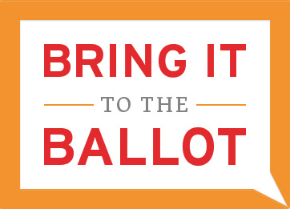
VOTING IN WISCONSIN - AND - THE VOTER PHOTO ID LAW
Speaker’s Bureau
Government Accountability Board

Slide 2
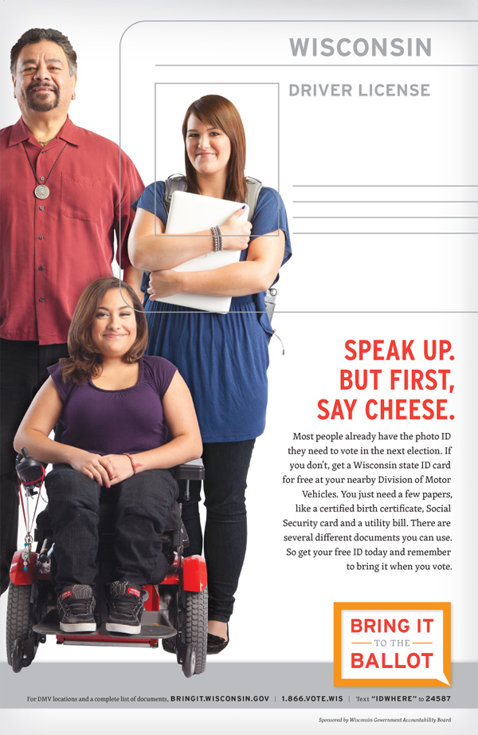
-PRESENTATION OUTLINE-
Voter Eligibility
Acceptable Photo ID
Registration and Proof of Residence
Absentee Voting
Election Day Voting

Slide 3
VOTER ELIGIBILITY

Slide 4
-VOTER ELIGIBILITY-
Who is eligible to vote in Wisconsin?
You must be at least 18 years of age
You must be a U.S. Citizen
You must reside at your current address for at least 28 days*
*If you have lived at your current address less than 28 days, you may be eligible to vote from the address you last lived in Wisconsin for 28 days

Slide 5
-VOTER ELIGIBILITY-
Who cannot vote in Wisconsin?
You cannot vote if you are serving any part of a felony sentence.
You cannot vote if you have been adjudged incompetent
You cannot vote if you placed a bet or a wager on the outcome of the election
You cannot vote if you have already voted in that election

Slide 6
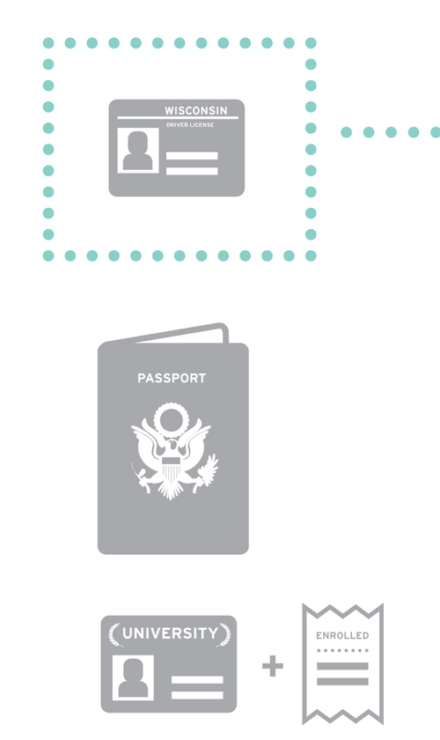
ACCEPTABLE PHOTO ID

Slide 7
-ACCEPTABLE PHOTO ID-
-Important Notes- 1)There is no such thing as a separate “Voter ID” card 2) Some Absentee voters are exempt.

Slide 8
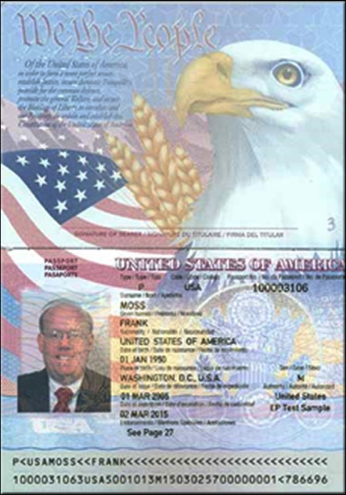
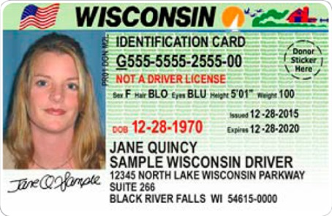
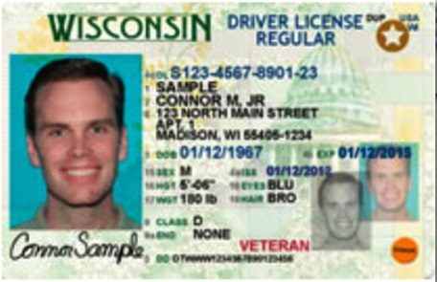
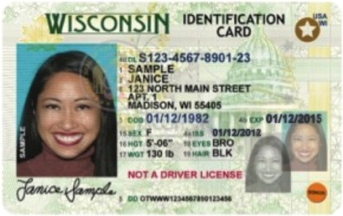
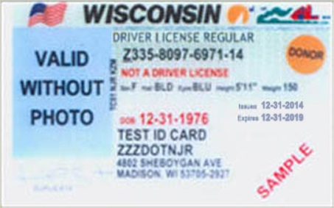
-ACCEPTABLE PHOTO ID-
State of Wisconsin Driver License*
State of Wisconsin ID Card*
U.S. Uniformed Service ID Card*
U.S. Passport (Book or Card)*
* These accepted IDs should be unexpired or if expired, after the date of the most recent general election: Currently November 4, 2014.

Slide 9
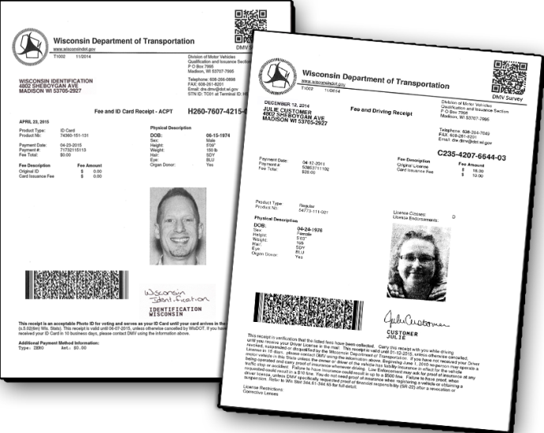
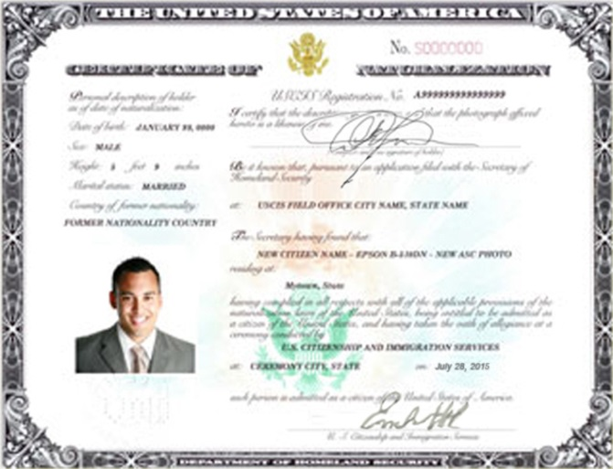
-ACCEPTABLE PHOTO ID-
State of Wisconsin Driver License or ID card Receipt
Certificate of Naturalization
Tribal ID Card

Slide 10
-ACCEPTABLE PHOTO ID-
College, University or Tech College Student IDs*
*Additional Proof of Enrollment is Required
Student’s name
Student’s signature
Student’s photo
Date the card is issued
Date the card expires*
*Date must be not more than 2 years from date of issuance.

Slide 11
-ACCEPTABLE PHOTO ID-
An acceptable photo ID for voting purposes includes:
Elector’s Photograph
Elector’s Name
Valid Expiration Date
A CURRENT ADDRESS IS NOT REQUIRED.

Slide 12
-ACCEPTABLE ID WITHOUT PHOTO-
There are 3 types of IDs WITHOUT PHOTO that can be used for voting purposes:
Citation dated within 60 days of the election
Notice of Intent to Revoke or Suspend a Driver License dated within 60 days of the election
State of Wisconsin ID card WITHOUT Photo issued for religious objection to being photographed

Slide 13
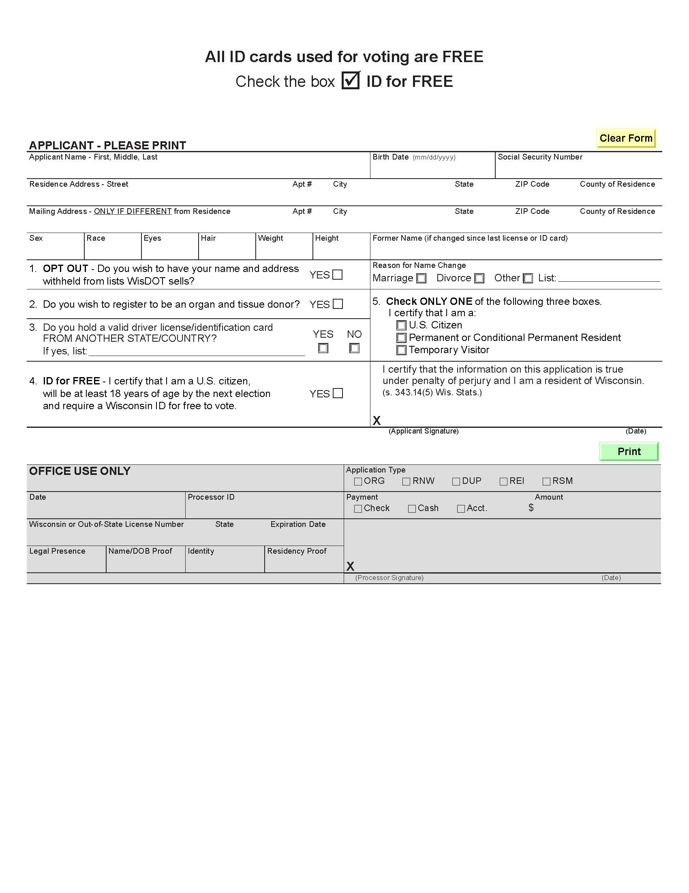

Slide 14
-ACCEPTABLE PHOTO ID-
Birth Certificate
An elector does not need a birth certificate to vote. However, a certified birth certificate may be required to obtain some forms of identification.
If you do not have a certified birth certificate available, the DMV has a petition process to verify your birth record for free.

Slide 15
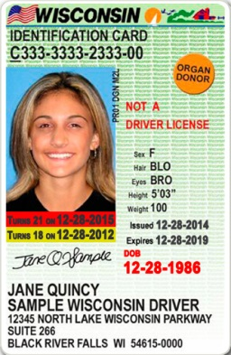
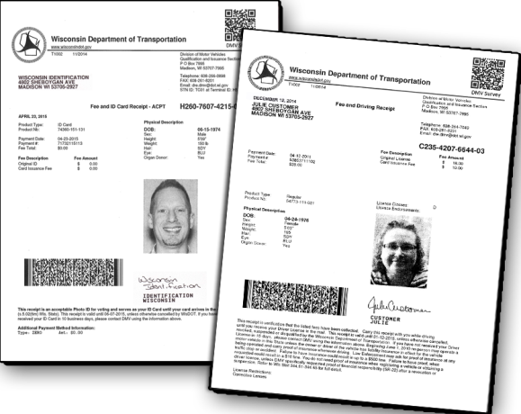
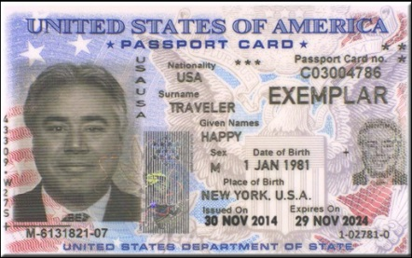
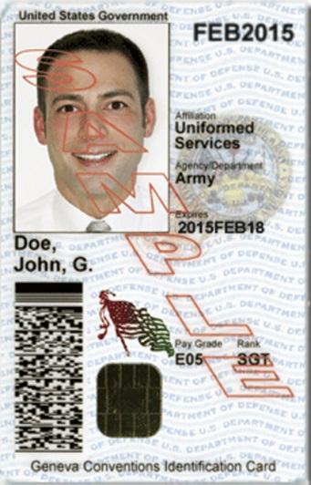
-ACCEPTABLE PHOTO IDS -
WI DRIVER OR
WI STATE ID RECEIPT
UNIVERSITY / COLLEGE / TECH
+ ENROLLMENT VERIFICATION
WI STATE ID CARD
TRIBAL ID
WI DRIVER LICENSE
U.S. UNIFORMED SERVICES
U.S. PASSPORT BOOK OR CARD
CERTIFICATE OF NATURALIZATION
VALID WITHOUT PHOTO

Slide 16
REGISTRATION & PROOF OF RESIDENCE

Slide 17
-REGISTRATION & PROOF OF RESIDENCE-
Who needs to register?
First time voters
If you moved
If you changed your name

Slide 18
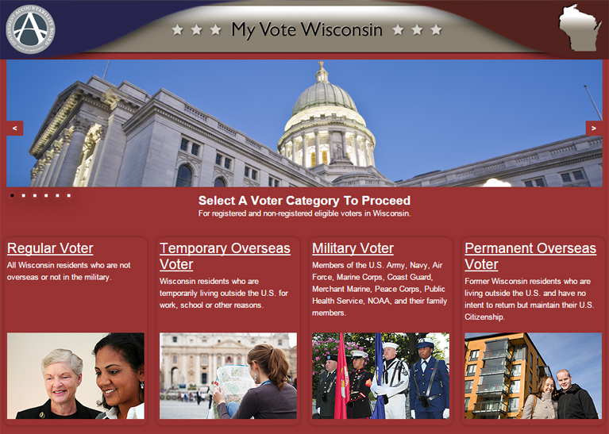
-REGISTRATION & PROOF OF RESIDENCE-
https://MyVote.wi.gov

Slide 19
-REGISTRATION & PROOF OF RESIDENCE-
How to Register:
By Mail
By Special Registration Deputy
Municipal Clerk’s Office
At the Polling Place

Slide 20
-REGISTRATION & PROOF OF RESIDENCE-
Photo ID versus Proof of Residence:
Proof of Residence documents prove your address
Proof of Identification documents prove who you are

Slide 21
-REGISTRATION & PROOF OF RESIDENCE-
What can be used as Proof of Residence?
A valid, unexpired, Wisconsin Driver License or Wisconsin State ID Card
A document issued by a unit of government
A utility bill, good for 90 days
A bank statement
This is not a complete list, there are many documents that may qualify as Proof of Residence. Contact G.A.B. or your clerk if you are unsure.

Slide 22
-REGISTRATION & PROOF OF RESIDENCE-
About Proof of Residence:
Your proof of residence must include your current name and current address
You may show your proof of residence electronically on your phone or your computer

Slide 23
ABSENTEE VOTING

Slide 24
-ABSENTEE VOTING-
Where and when can I vote by absentee ballot?
By Mail-
Make a request no later than the Thursday before the Election
You can make your request in writing by mail , email, fax or delivery
Send a copy of your photo ID with your request
Ballot will be sent to you by mail
In-Person in Clerk’s Office-
3rd Monday before the election through the Friday before the election
Occurs in your municipal clerk’s office during their office hours
You cannot vote in-person absentee on weekends or the Monday before the Election
Must show your original photo ID

Slide 25
-ABSENTEE VOTING-
Providing Photo ID when Voting Absentee
VOTERS WHO MUST PROVIDE ID
Regular absentee voters requesting a ballot by mail- Send a copy of ID with request
Regular absentee voters requesting a ballot by email or fax – Send a copy of ID with request
In-person voters in the clerk’s office – Show your ID to the clerk

Slide 26
-ABSENTEE VOTING-
VOTERS WHO ARE EXEMPT FROM SHOWING PHOTO ID
Military voters are exempt only if they vote by absentee ballot – Can also get ballot online at MyVote.wi.gov
Permanent Overseas voters are exempt only if they vote by absentee ballot- Can get federal only ballot online at MyVote.wi.gov
Confidential Electors

Slide 27
-ABSENTEE VOTING-
Providing Photo ID when Voting Absentee
VOTERS WHO CAN PROVIDE A SUBSTITUTE FOR PHOTO ID:
Indefinitely confined electors
Voters in care facilities visited by Special Voting Deputies
Voters in other care facilities – eligible, but not visited by Special Voting Deputies

Slide 28
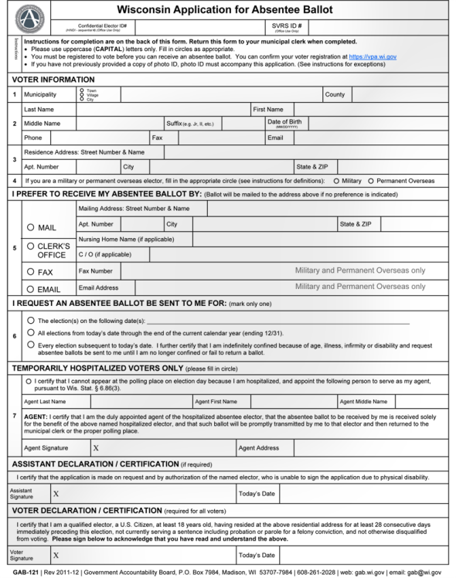
-ABSENTEE VOTING-
Wisconsin Application for Absentee Ballot
GAB-121 form

Slide 29
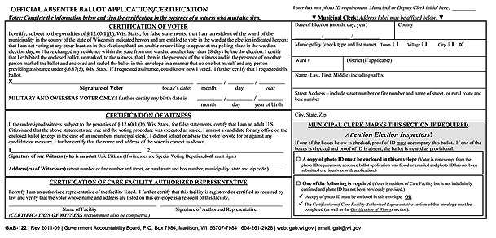
-ABSENTEE VOTING-

Slide 30
-ABSENTEE VOTING-

Slide 31
-ABSENTEE VOTING-

Slide 32
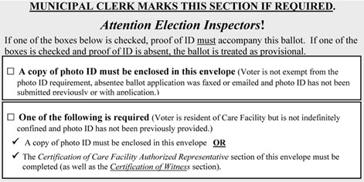
-ABSENTEE VOTING-

Slide 33
ELECTION DAY VOTING

Slide 34
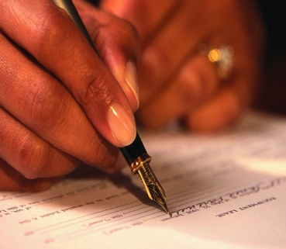
-ELECTION DAY VOTING-
1) STATE Your Name & Address
2) SHOW Your Acceptable Photo ID
3) SIGN the Poll Book

Slide 35
-ELECTION DAY VOTING-
What if...
I don’t have an ID on Election Day?
THERE ARE OPTIONS!
YOU CAN CAST A PROVISIONAL BALLOT

Slide 36
-ELECTION DAY VOTING-
Are there accommodations available at the polls?
Accessible voting equipment
Curbside voting
Exemption from signing poll book if unable to sign due to disability
You may have someone assist you with the voting process

Slide 37
-ELECTION DAY VOTING-
Be nice to your
Poll Worker!

Slide 38
HELP US SPREAD THE WORD
TV Ads, Billboards and Print Materials

Slide 39
-WEBSITE-
http://bringit.wisconsin.gov

Slide 40
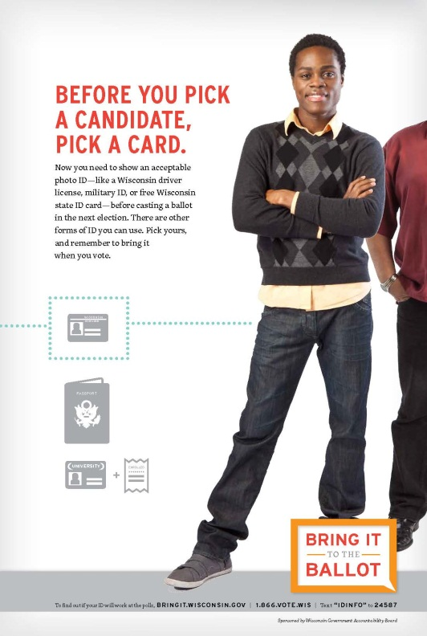
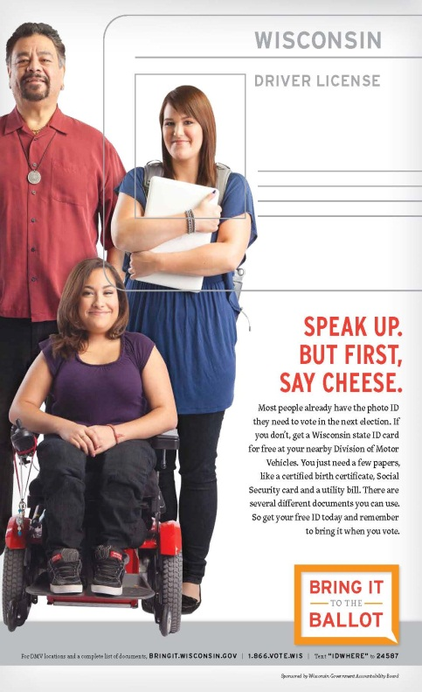
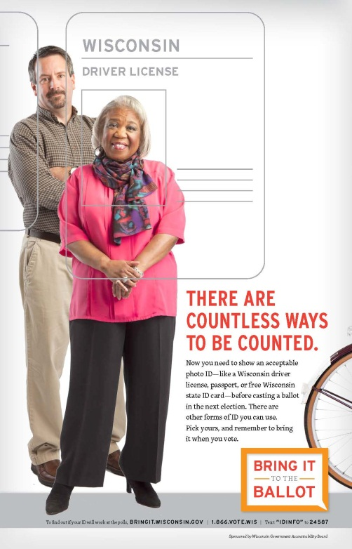
-POSTERS-
WWW.BRINGIT.WI.GOV

Slide 41
-SUMMARY-
This presentation and more is available at:
http://bringit.wisconsin.gov http://gab.wi.gov https://MyVote.wi.gov More Questions?
GAB Help Desk Phone Number: (608) – 261 – 2028
GAB Help Desk Email: GABHelpdesk@wi.gov
1-866-VOTE-WIS

Slide 42
THANK YOU!
And Don’t forget to bring it to the ballot

