Slide 1
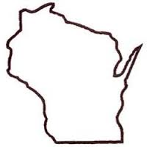
Wisconsin Elections Commission
WEC
Best Practices and Key Takeaways from the
2020-2021 Elections
May 5, 2021

Slide 2
Agenda
Updates
Indefinitely Confined Voters
Accessibility
A Few Takeaways from the Elections…
LBOC vs MBOC
Looking Ahead
Training Reminders/Resources
Notes:
Agenda

Slide 3
Updates
WEC
Special Election for AD 37 scheduled for July 13; primary will be held on June 15 if required.
Proposals to make changes in various election administration procedures, such as absentee voting and election observers, are being debated by the state legislature. No bills have passed and been signed into law yet.
Election notices have been reformatted for usability and will be available for next year’s spring elections.
Notes:
Updates

Slide 4
Indefinitely Confined Voters
Indefinitely Confined 30-day Letter (available in WisVote) | Optional Indefinitely Confined Clean-Up Letter (available in clerk communications)
Statutorily Required under Wis. Stat. § 6.86(2)(b). Send to indefinitely confined absentee voters who did not return their by-mail April ballot. Clerk is required to send this letter before deactivating an indefinitely confined absentee request. Voter must respond to letter, otherwise absentee request is deactivated. | Optional. Send to any indefinitely confined voter. Voter is not required to respond to the letter. Non-response means that the voter remains on the absentee request list.
Notes:
Indefinitely Confined Voters

Slide 5
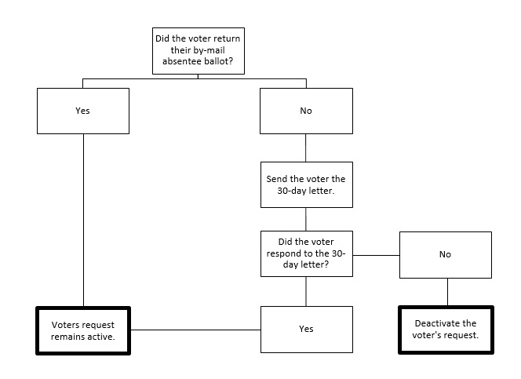
30-day Letter Process
Notes:
30-Day Letter Process

Slide 6
Indefinitely Confined Voters Reminders
WEC
Indefinitely confined is a self-certification that a voter makes based on their current circumstances.
You must send out the indefinitely confined 30-day letter to any voter that didn’t return their by-mail absentee ballot.
You cannot deactivate any indefinitely confined voter’s absentee request without sending the letter.
The letter is available on WisVote and the Elections website. There are instructions on how to get your list of indefinitely confined voters on The Learning Center.
If a voter spoiled their absentee ballot and voted in-person, they did not return their absentee ballot.
Notes:
Indefinitely Confined Voters Reminders

Slide 7
Accessibility
WEC
There are two types of voting equipment:
Tabulator – required for any municipality that has more than 7,500 voters.
Accessible Voting Equipment – required for EVERY municipality.
The Dominion ICE serves as both a tabulator and an accessible voting machine.
Anyone can use the accessible voting equipment.
Accommodations are available for voters. These include:
Curbside voting
Large print ballots
Having an assistant help them fill out their ballot or state their name and address.
Resources: https://elections.wi.gov/node/7383
Notes:
Accessibility

Slide 8
A Few Takeaways from the Elections…
WEC
Public health guidance may change, but will continue to be part of election administration.
Inspectors need to practice counting votes as part of their pre-election training.
Determining voter intent
Registered vs unregistered write-ins
Review “Counting Votes” Manual: http://elections.wi.gov/manuals/counting-votes
Election inspectors need to be trained on how their voting equipment operates, how to turn it on, jams and other troubleshooting.
Notes:
A Few Takeaways from the Elections

Slide 9
Absentee Voting
WEC
Proper documentation is required
Must be a Registered Voter
EL-131 on file
WisVote
MyVote Wisconsin
Exempts Military Voters
Must Provide Proof of Identification, if required
In-Person absentee voting may not begin any earlier than 14 days before the election.
Absentee Ballot Tracking
All absentee ballots are required to be tracked in WisVote, including applications, ballots sent, ballots returned.
WisVote reliers should work with their providers and provide this information in a timely manner.
Notes:
Absentee Voting

Slide 10
LBOC vs MBOC
 | Local Board of Canvassers | Municipal Board of Canvassers
Who makes up the Board of Canvassers? | All election inspectors (not including greeters). | Municipalities with only one polling place: the election inspectors. Municipalities with more than one polling place: the clerk and two qualified electors of the municipality.
What are their duties? | Compare poll lists and correct any mistakes. Determine if any ballots are defective and set them aside. If poll counts are off, determine why or potentially draw down if no reason can be determined. Tally or review vote totals (including write-ins). Secure ballots and deliver to the municipal clerk. | Review the poll list and Inspector’s Statement. Review tally sheets and electronic vote records. Break any municipal race ties, if needed. Certify the results of the municipal race(s) or referenda.
Notes:
LBOC vs MBOC

Slide 11
LBOC vs MBOC
 | Local Board of Canvassers | Municipal Board of Canvassers
When do they convene? | Immediately after polls close until all ballots have been canvassed at their polling place. | If election inspectors constitute the MBOC: election night. They must reconvene if any provisional ballot information is delivered by the voter. No provisional ballots: no later than 9am on the Monday after the election. Provisional ballots are issued: between 4pm Friday and 9am Monday after the election.
Do they have to convene after every election? | Yes. | No, the MBOC only has to convene if there is a municipal contest, including a referendum, on the ballot.
How do they notice the meeting? | Type D Notice. | If meeting on election night: Type D Notice. If meeting after election night: 24-hour open meeting notice.
Notes:
LBOC vs MBOC

Slide 12
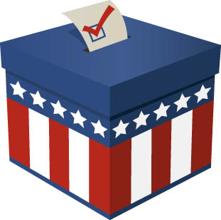
Board of Canvassers Reminders
Election results are not complete until certified by the Board of Canvassers.
Make sure they are properly noticed either in your Type D notice or open meeting notice.
Board of Canvassers serve a 2-year term commencing on January 1 of even-numbered years.
The BOC may need to reconvene to correct errors in the original canvass.
Notes:
Board of Canvassers Reminders

Slide 13
Looking Ahead
Candidate Filings: ballot access procedures and documents, deadlines
Appointing Election Inspectors: process, party lists, public records requests
Training Compliance: requirements, reporting, resources
Notes:
Looking Ahead

Slide 14
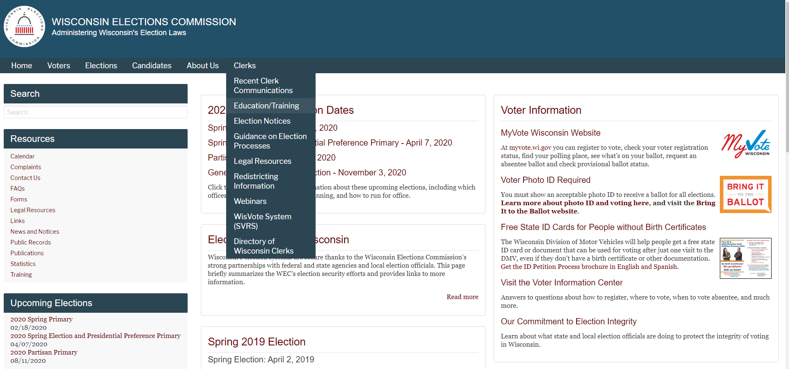
Education/Training Page
https://elections.wi.gov/clerks/education-training
http://elections.wi.gov/clerks/education/training
Notes:
Education/Training Page

Slide 15
Training Reminders/Resources
WEC
New Municipal Clerk Checklist
Training Terms
Training Resources
Poll Worker Training Agendas
WEC Learning Center
Election Administration TTX
2020-2021 EA Webinars
Election Day/Election Administration Manuals
Other topic specific manuals (recall, recount, SVD voting, referenda, etc.)
Notes:
Training Reminders & Resources

Slide 16
WEC
Questions?
Notes:
Questions?

Slide 17
Thank You!
WEC
Questions?
Email: elections@wi.gov
Elections Helpdesk: 608-261-2028
Notes:
Thank you!

