Slide 1
Wisconsin Elections Commission
WEC
April Election Readiness
March 10, 2021
Notes:
April Election Readiness

Slide 2
Agenda
Counting Write-In Votes
Voter Intent
Registered Write-Ins
Training Examples
Accessibility
Photo ID Expiration Dates
Public Health Reminders
Returning Absentee Ballots to the Polling Place
Notes:
Agenda

Slide 3
Registered Write-Ins
WEC
A candidate who wishes to run as a write-in is required to file a Campaign Registration Statement (CF-1) by 12:00 p.m. the Friday before the election.
If the candidate has already filed an CF-1 with the filing officer and decides to run as a write-in, WEC recommends the candidate submit a written statement to that effect to the filing officer.
The municipal clerk should give the election inspectors a list of registered write-ins. A voter who asks if there are any registered write-ins should be allowed to look at the list. The list should not be posted or otherwise offered to voters.
Notes:
Registered Write-Ins

Slide 4
Voter Intent
WEC
Wis. Stat. § 7.50(2)(em): When write-in votes may be counted for registered vs. non-registered candidates
Wis. Stat. § 7.50(2)(d): When write-in votes may be counted vs. ballot candidate votes
The Four Principles for Determining Eligibility of Write-In Votes.
Notes:
Voter Intent

Slide 5
The Four Principles…
WEC
Notes:
The Four Principles…

Slide 6
A Few Tips about Counting Votes…
WEC
There may be certain contests on the ballot that you will know ahead of time to only count registered write-in votes:
When the number of ballot candidates equals the number of votes the voter is entitled to cast
There may be certain contests on the ballot that you will know ahead of time to count all write-in votes, registered or unregistered:
If there is no ballot candidate on a vote for 1 contest
If there are fewer ballot candidates for a contest than the number of votes the voter is entitles to cast
Regardless, the presence of a write-in vote, registered or not, may affect a marked ballot candidate.
Notes:
A Few Tips about Counting Votes…

Slide 7
A Few Tips about Counting Votes…
WEC
Inspectors need to go through the ballots when the polls close to determine if there were any write-in votes not counted by the voting equipment.
A write-in vote does not have to have the oval or arrow next to it filled in on an optical scan ballot. A voter can indicate their intent though other means, such as circling a candidate on the ballot.
Review “Counting Votes” Manual: http://elections.wi.gov/manuals/counting-votes
Important note: If the winner of a contest declines to serve, it creates a vacancy for that office.
Notes:
A Few Tips about Counting Votes…

Slide 8
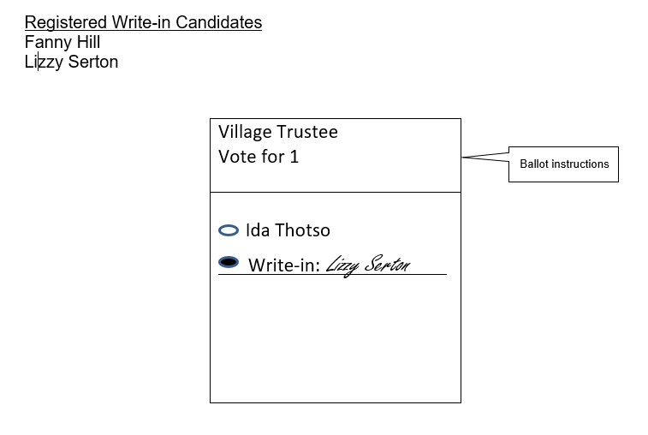
Training Examples: Voter 1
WEC
Notes:
Training Examples: Voter 1

Slide 9
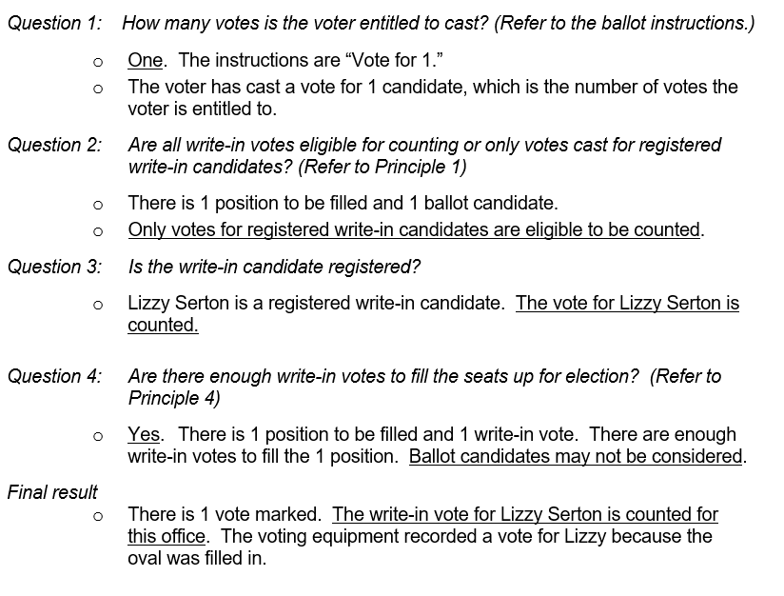
Voter 1: Results
WEC
Notes:
Voter 1: Results

Slide 10
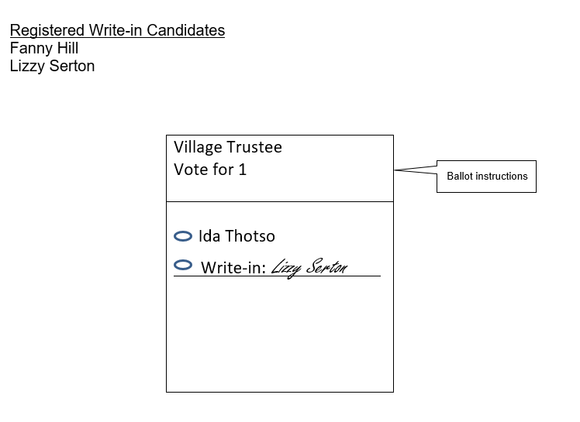
Training Examples: Voter 2
WEC
Notes:
Training Examples: Voter 2

Slide 11
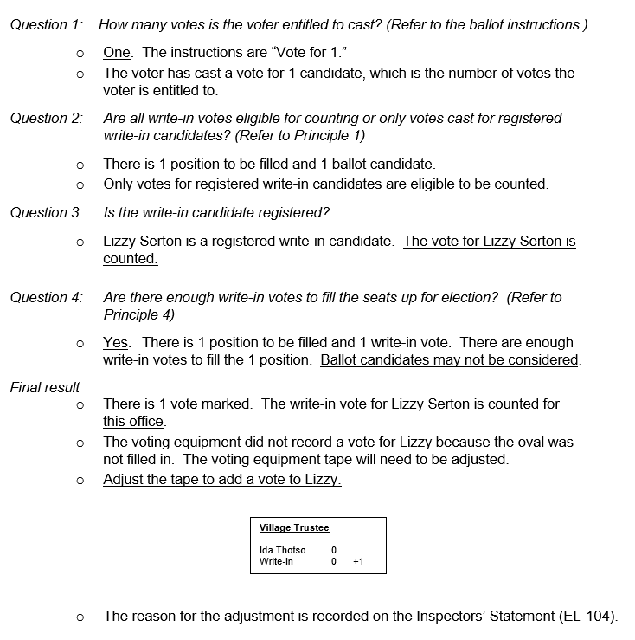
Voter 2: Results
WEC
Notes:
Voter 2: Results

Slide 12
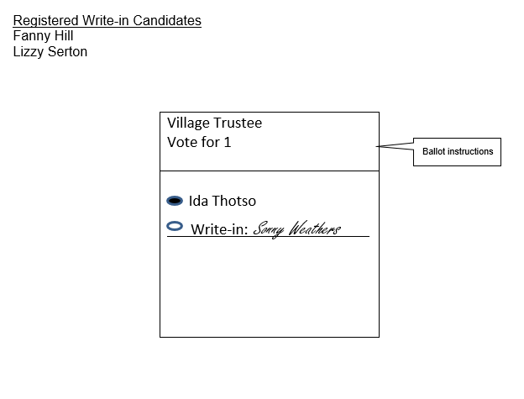
Training Examples: Voter 3
WEC
Notes:
Training Examples: Voter 3

Slide 13
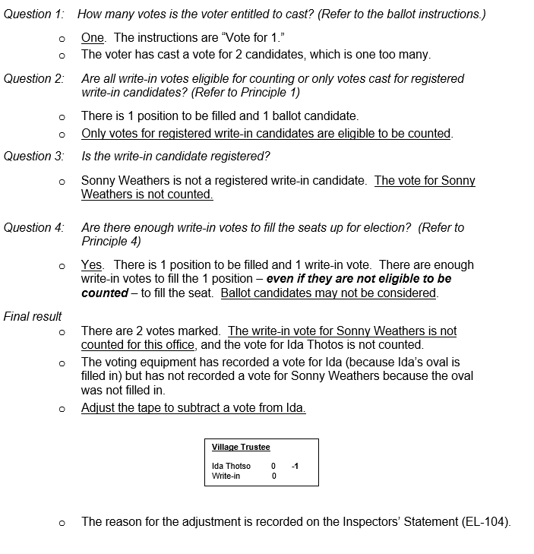
Voter 3: Results
WEC
Notes:
Voter 3: Results

Slide 14
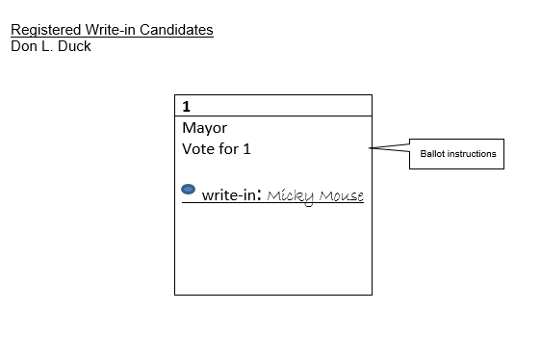
Training Examples: Voter 4
WEC
Notes:
Training Examples: Voter 4

Slide 15
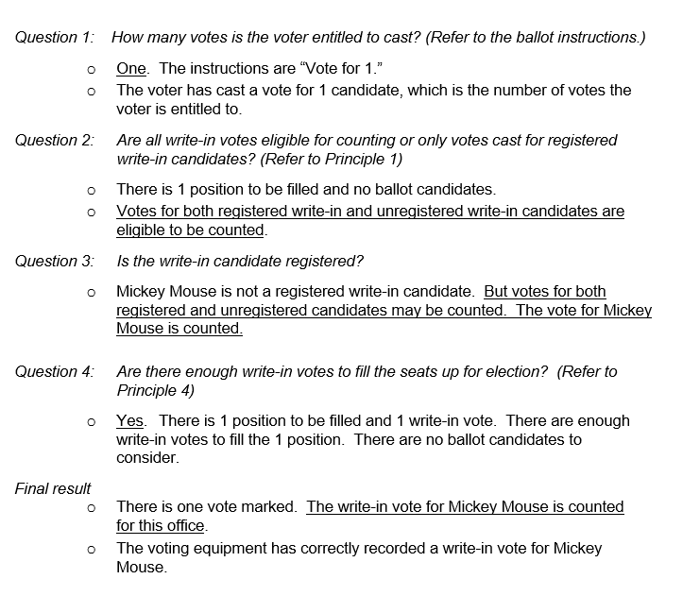
Voter 4: Results
WEC
Notes:
Voter 4: Results

Slide 16
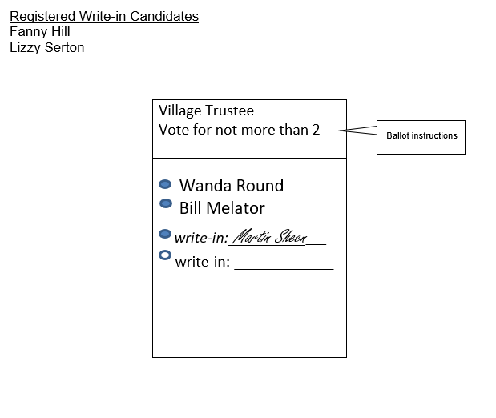
Training Examples: Voter 5
WEC
Notes:
Training Examples: Voter 5

Slide 17
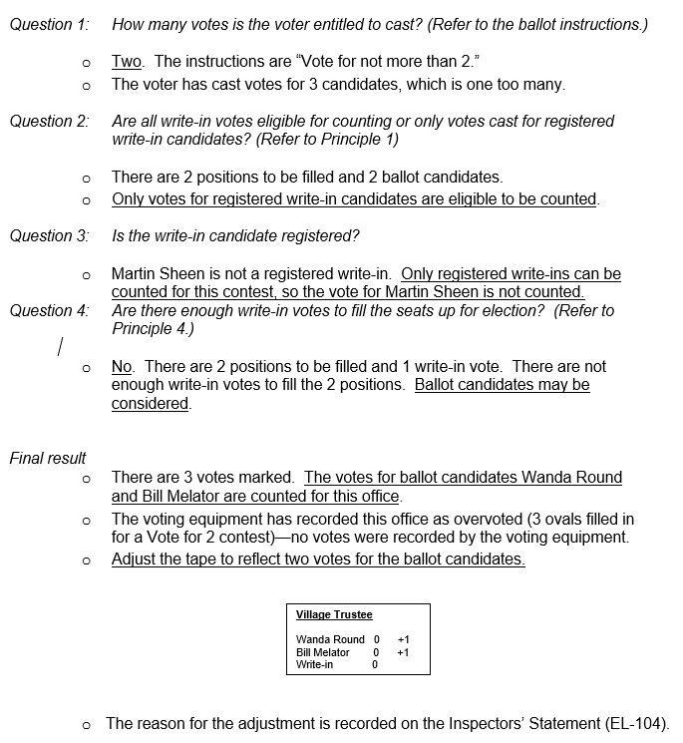
Voter 5: Results
WEC
Notes:
Voter 5: Results

Slide 18
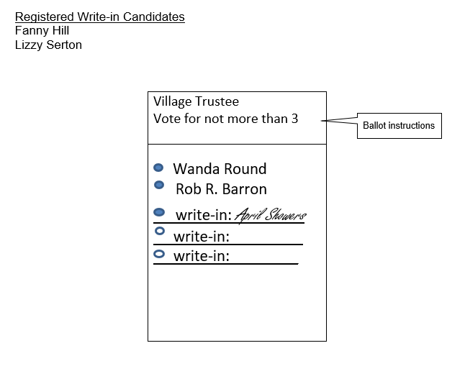
Training Examples: Voter 6
WEC
Notes:
Training Examples: Voter 6

Slide 19
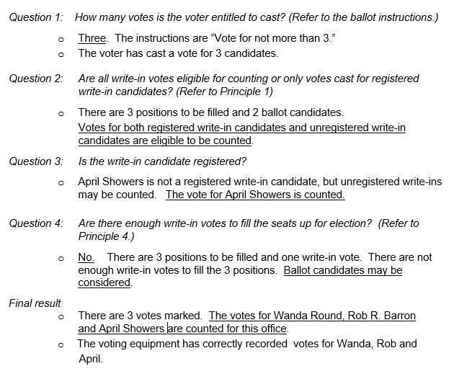
Voter 6: Results
WEC
Notes:
Voter 6: Results

Slide 20
Accessibility Reminders
WEC
You must have accessible voting equipment set up and turned on. Please note that the Sequoia Edge and Dominion Image Cast Evolution (ICE) have dual purposes. Include accessible voting equipment in your poll worker training.
Curbside voting is required at every polling place for individuals who are immunocompromised, have a disability, or who are elderly. Prepare a plan for curbside voting, including adding signage or having a greeter to alert poll workers when a voter needs curbside voting.
Accommodations are allowed for the requirement for voters to state their name and address. The name and address can be announced by the poll worker or an assistant of the voter’s choosing.
Notes:
Accessibility Reminders

Slide 21
Accessibility Reminders
Ballot drop boxes must be accessible. Please ensure that they are on flat and paved ground and having nearby accessible parking.
Have a clear face mask or scrap paper available for voters who rely on lip reading for communication.
If your poll worker cannot wear a face mask due to a disability, please provide an accommodation for them to work outside as a greeter or work independently away from other poll workers and voters.
Order supplies as soon as possible by using the form available here: https://elections.wi.gov/clerks/guidance/accessibility/new-polling-place.
Notes:
Accessibility Reminders

Slide 22
Photo ID Expiration Dates
Unexpired/Expired after 11/3/2020
Wisconsin Driver License*
Wisconsin State ID
Wisconsin State ID or Driver License Receipt
Military ID – all different types
U.S. Passport
Certificate of Naturalization
Tribal ID
College/University/Tech College ID
Current enrollment document needed if expired
Can have expiration date before 11/3/2020
Notes:
Photo ID Expiration Dates

Slide 23
Photo ID Expiration Dates
Unexpired
Wisconsin State ID or Driver License Receipt
Valid for 45 days
IDPP Receipt
Valid for 60 days
Certificate of Naturalization
Cannot be issued more than two years earlier
Veteran Affairs ID
Notes:
Photo ID Expiration Dates

Slide 24
Photo ID Expiration Dates
Wisconsin Driver License for people over 60
Expiration date extended to May 2021 due to COVID
Any Wisconsin driver license that expired after March 23, 2020 is still valid for voting purposes
Shouldn’t see too many of these at the polls
Notes:
Photo ID Expiration Dates

Slide 25
Public Health Guidelines
WEC
We are not public health officials – we are election officials
If you are showing symptoms of COVID-19, do not report to your office or polling place if on Election Day
COVID-19 is an ever-evolving situation. The WEC will continue to provide public health guidance as it becomes available
Public Health Videos and Guidance
Poll Worker Training Videos: recommended best practices
Notes:
Public Health Guidelines

Slide 26
Safety Procedures at the Polls
WEC
Voters should clean their hands using soap and water (or hand sanitizer) upon entering and leaving the voting area.
Incorporate social distancing of at least 6 feet when possible.
Utilize poll workers or election helpers to assist voters with proper hand hygiene. Direct them to hand washing stations/assist with sanitizing spray.
Masks for voters may be provided and encouraged, but cannot be required as a condition of voting.
Notes:
Safety Procedures at the Polls

Slide 27
Safety Procedures at the Polls
WEC
Face to Face interactions should be limited.
Tabletop barriers should be used at the voter check-in and registration tables where lengthier interactions are common.
Use larger rooms or areas of the polling place that allow for more space and increased ventilation.
Notes:
Safety Procedures at the Polls

Slide 28
Returning Absentee Ballots at the Polling Place
Voters who have been issued an absentee ballot are
allowed by law to return the ballot to the municipal clerk’s
office and/or the polling place on Election Day, unless they
are in an absentee central count municipality.
An election inspector or greeter could be designated for
accepting absentee ballots returned to the polls on
Election Day and placing them in a secure container for
processing.
Election officials can review the certification of the
absentee ballot and inform voters of any deficiencies, how
they can be corrected (if possible) and any other options
are available for the voter.
Notes:
Returning Absentee Ballots at the Polling Place

Slide 29
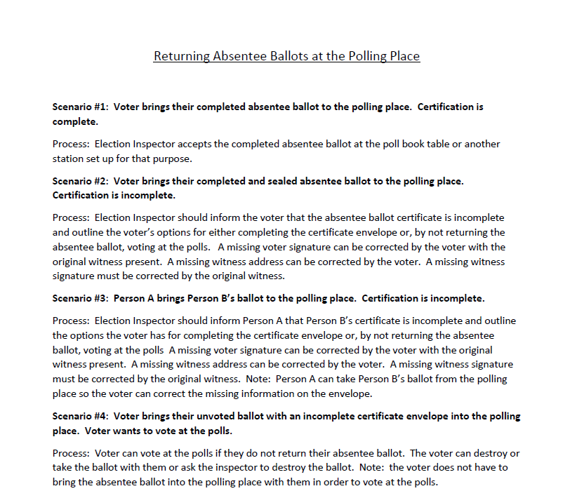
Returning Absentee Ballots at the Polling Place
Notes:
Returning Absentee Ballots at the Polling Place

Slide 30
WEC
Questions?
Notes:
Questions?

Slide 31
Thank You!
WEC
Questions?
Email: elections@wi.gov
Elections Helpdesk: 608-261-2028

