Slide 1
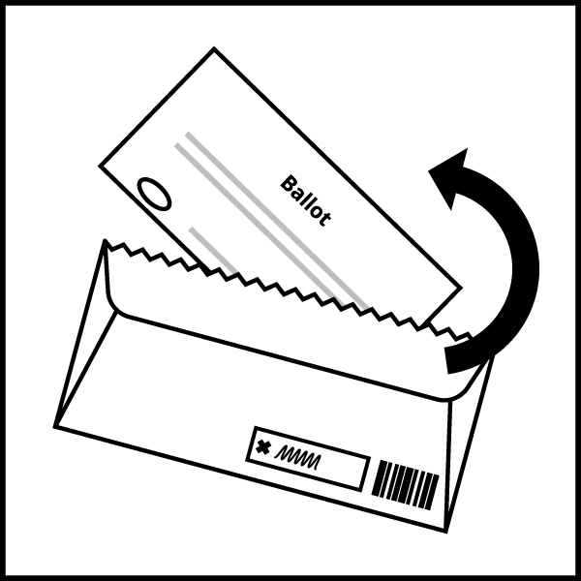
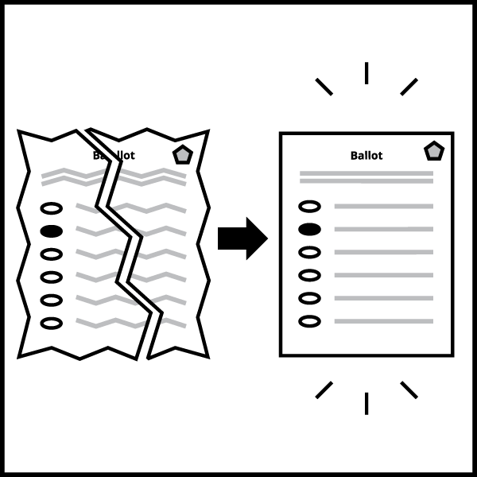
Absentee Processing
1
Absentee Carrier Envelopes Poll workers document the serial number of the tamper-evident seal as they open each envelope of absentees.
2
Poll Workers Check Ward on Label Poll workers verify that each absentee envelope is for a ward served by their polling location.
3
Poll Workers Check Certificate Certificates missing a signature or witness address are set aside to be rejected at 8 p.m.
4
Poll Workers Check Ineligible List If an absentee voter is on the ineligible list, poll workers will follow the Challenge procedure.
5
Poll Book Poll Workers announce each absentee voter’s name and address at poll book. Voter slip number is assigned if voter is registered and hasn’t already voted.
6
Open Envelopes, Flatten Ballots Envelopes are opened only after a voter slip number is assigned. Ballots are unfolded and flattened.
Duplication, if needed Two poll workers work together to determine voter intent and duplicate a ballot if the tabulator will not be able to read it – ballots that are marked with green or red pen, torn, overvoted, printed on regular paper, or marked creatively (not filling in the ovals).
7
8
Scan Ballots are counted by the DS-200. The Clerk’s Office tested every DS-200 for accurate vote tabulation of every ballot style and every office on the ballot 10 days before the election.

