Slide 1
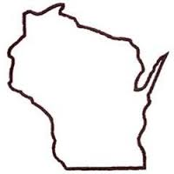

Wisconsin Elections
Commission
WEC
Prep for the February Primary: Completing Election Forms
January 27, 2021
Notes:
Prep for the February Primary: Completing Election Forms

Slide 2
Agenda
SVDs & the Spring Elections
Inspectors’ Statement (EL-104)
Voter Registration Application (EL-131)
Tally Sheet (EL-106)
Reminders
Additional Training Exercises
Notes:
Agenda

Slide 3
SVDs & the Spring Elections
WEC
  Due to feedback from the DHS/Division of Public Health, the Commission determined that SVDs will not be able to enter care facilities for the February primary.
    State law requires the ballot to be sent to the voter if SVDs cannot visit the facility.
    Decision will be revisited for the April election.
  Sample Care Facility letter
  Training Resources
  Please see the memo/related documents in Recent Clerk Communications: https://elections.wi.gov/node/7311
Notes:
SVDs & the Spring Election

Slide 4
WEC
Inspectors’ Statement
(EL-104)
Notes:
Inspectors’ Statement (EL-104)

Slide 5
Inspectors’ Statement
WEC
  Lists all blank, challenged, damaged, defective, overvoted, objected to, provisional and rejected ballots, etc.
  Lists voter statistics such as number of voters, absentee and provisional ballots
  Lists seal numbers from voting equipment
  Lists certification of results from chief inspectors and election inspectors who worked at the polls.
Notes:
Inspectors Statement

Slide 6
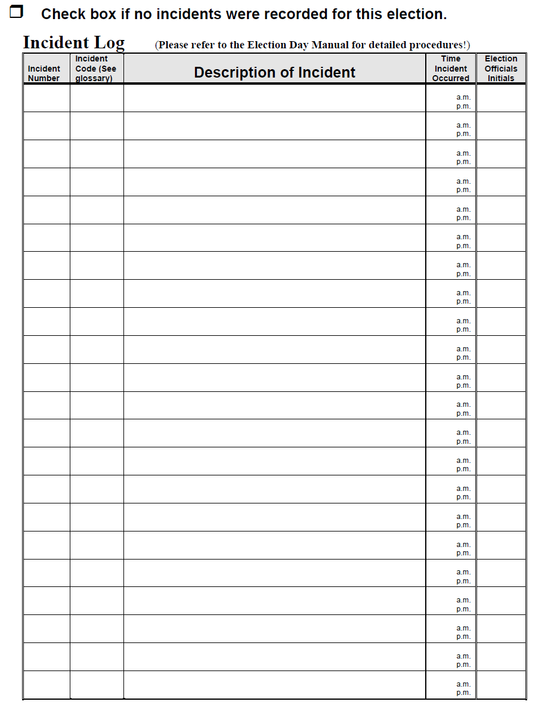
Sample Inspectors’ Statement
Notes:
Sample Inspectors’ Statement (EL-104)

Slide 7
Before the Polls Open
WEC
  List the polling place details (ward, municipality, county) and election date.
  The clerk lists the VE voting unit # and tamper-evident seal numbers as part of the pre-election testing of the voting equipment.
  The Chief Inspector verifies the numbers against the EL-104 before the polls open; initials form
    If numbers are missing, contact the clerk.
Notes:
Before the Polls Open

Slide 8
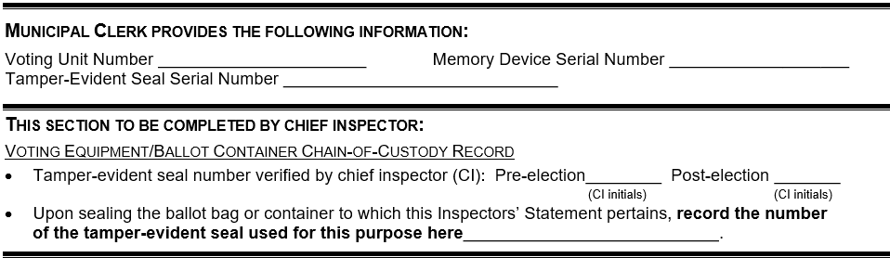
Voting Equipment
Chain of Custody
WEC
001
001-101
395149
RR
Notes:
Voting Equipment Chain of Custody (before the polls open)

Slide 9
Election Day Incidents
WEC
  The election inspectors record Election Day incidents on the log.
  Recording events accurately can help election officials reconcile at the end of the night and answer questions
  Better to record too much information rather than too little in the log.
  Unlikely to have a blank Incident Log
Notes:
Election Day Incidents

Slide 10
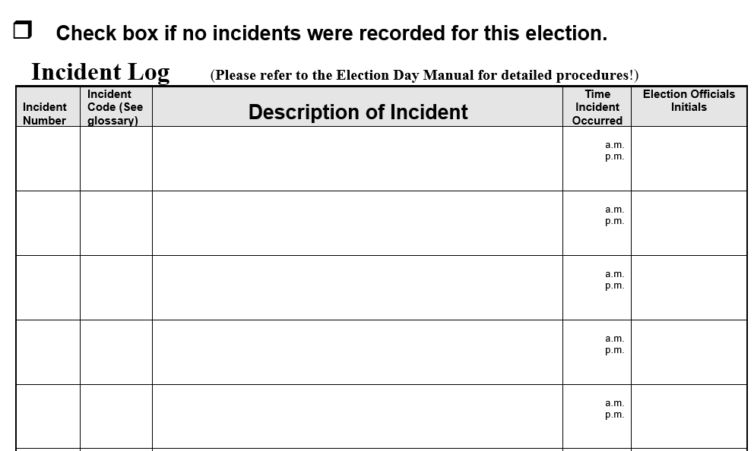
Incident Log Examples
WEC
1 X Polls open 7:02, no poll book 7:02 AC
2 R OV ballot remade optical scan 8:30 SG
3 X Voting Equipment jams, ballot reinserted 10:00 AC
4:00 MCS
WEC conducts an accessibility audit
4 X
5 RS Lori Jones Absentee Ballot rejected, no 8:10
voter signature MCS
Notes:
Incident Log Examples

Slide 11
After the Polls Close
WEC
Chief Inspector initials on EL-104 tamper-evident serial number on equipment matches the serial number written by clerk (Pre-election and Post-Election)
Chief Inspector writes tamper evident serial number contained on ballot bag on EL-104 and EL-101
Chief inspector or designated election inspector completes
  Include the total number of voters, number of absentee voters and number of provisional voters
All election inspectors sign the completed certificate – attach an additional sheet if needed
Chief inspector signs the certification that they have completed the required training
Notes:
After the Poll Close

Slide 12
Voting Equipment
Chain of Custody
WEC
001
001-101
395149
RR
RR
395150
Notes:
Voting Equipment Chain of Custody (after the polls close)

Slide 13
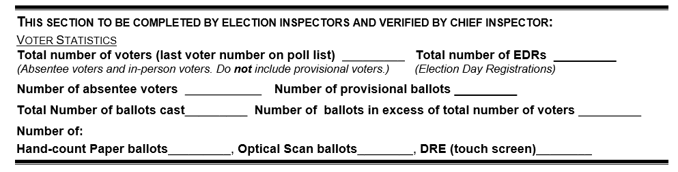
Voter Statistics
WEC
175
40
35
2
173
0
Notes:
Voter Statistics

Slide 14
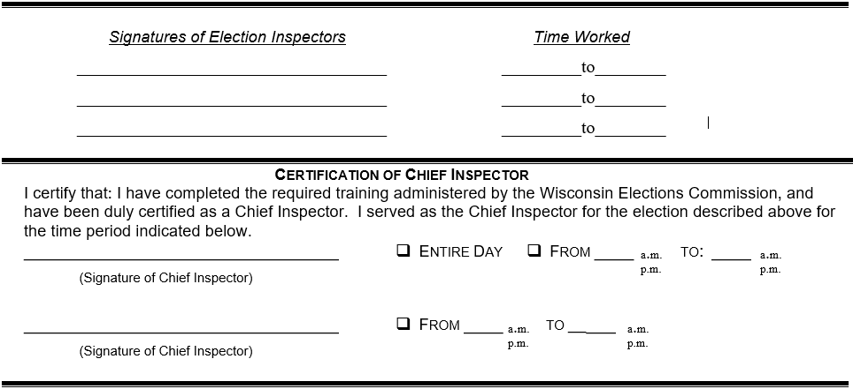

Election Officials
Certification
WEC
Amy Catrell
6 am
10 pm
10 pm
Shawn Gebert
6 am
Mari Lou Short
6 am
10 pm
Richard Rydecki
Notes:
Election Officials Certification

Slide 15
WEC
Voter Registration Application (EL-131)
Notes:
Voter Registration Application (El-131)

Slide 16
Voter Registration
Application (EL-131)
WEC
  Used whenever a first-time voter registers to vote or a current voter changes their name or address.
  Review of:
    Qualifications
    Phone number, address not required
    Address vs. mailing address
    Identification number
    Certification
    POR information (account number, residency)
Notes:
Voter Registration Application (EL-131)

Slide 17
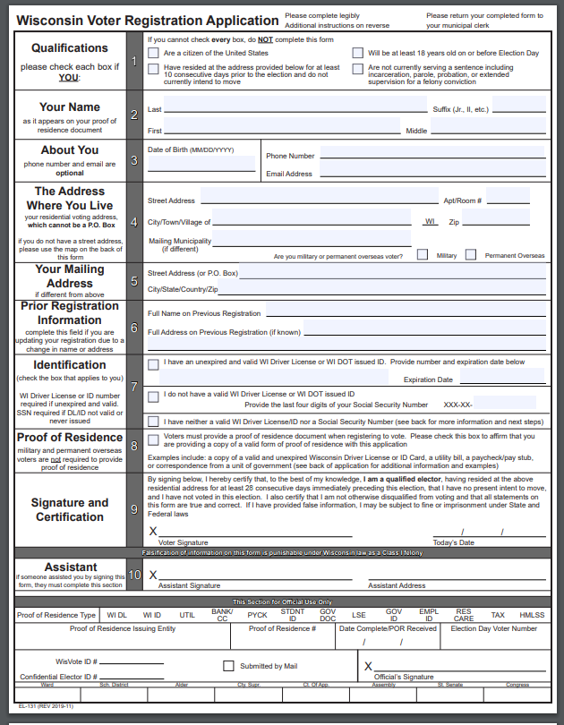
Voter Registration Application
(EL-131)
Notes:
Voter Registration Application (EL-131)

Slide 18
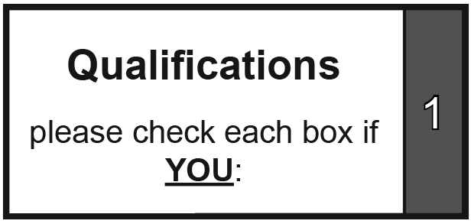
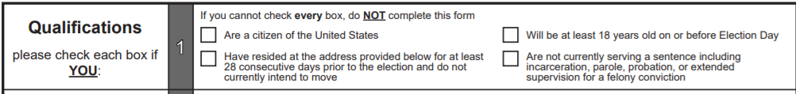
Voter Registration Application (EL-131)
Qualifications (Box 1)
Voters must be able to check each box
Notes:
Voter Registration Application (EL-131)

Slide 19
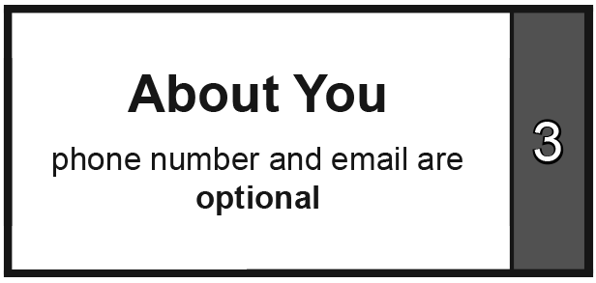
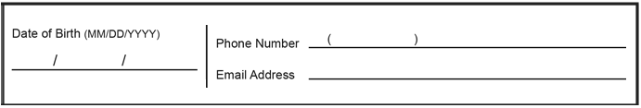
Voter Registration Application (EL-131)
About You (Box 3)
Notes:
Voter Registration Application (EL-131)

Slide 20
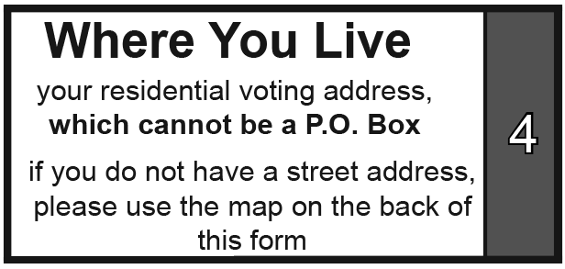
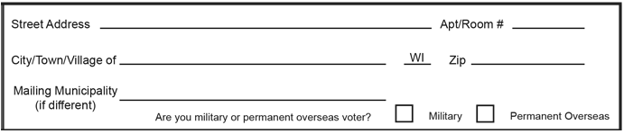
Voter Registration Application (EL-131)
The Address Where You Live (Box 4)
Notes:
Voter Registration Application (EL-131)

Slide 21
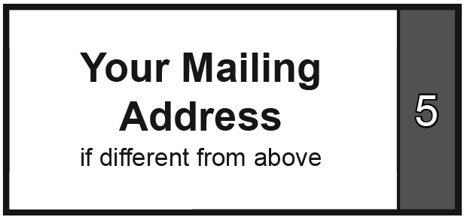
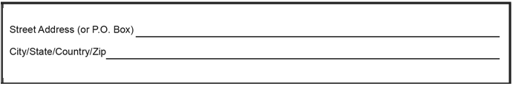
Voter Registration Application (EL-131)
Your Mailing Address (Box 5)
Notes:
Voter Registration Application (EL-131)

Slide 22
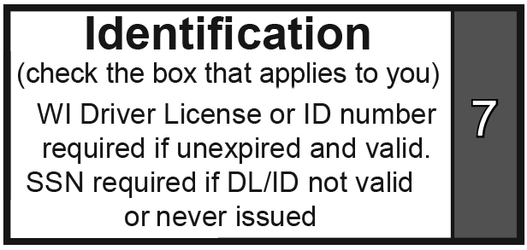
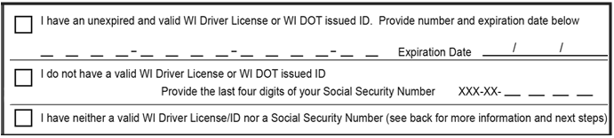
Voter Registration Application (EL-131)
Identification (Box 7)
Notes:
Voter Registration Application (EL-131)

Slide 23
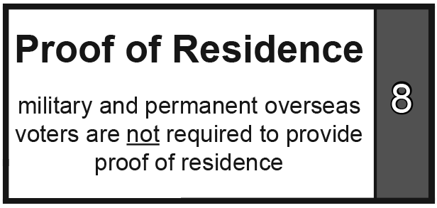
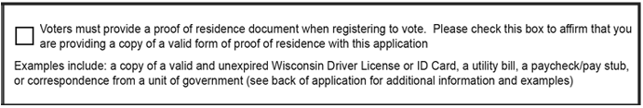
Voter Registration Application (EL-131)
Proof of Residence (Box 8)
Notes:
Voter Registration Application (EL-131)

Slide 24

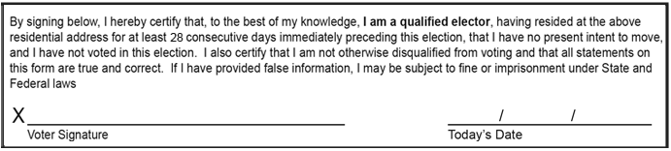
Voter Registration Application (EL-131)
Signature and Certification (Box 9)
Notes:
Voter Registration Application (EL-131)

Slide 25
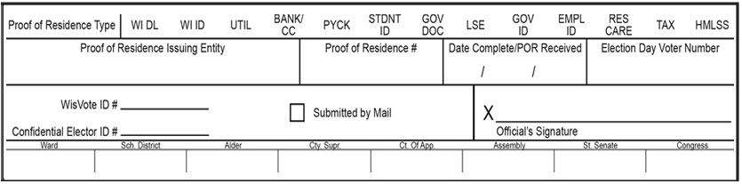
Voter Registration Application (EL-131)
Official Use Only section
Notes:
Voter Registration Application (EL-131)

Slide 26
WEC
Tally Sheet
(EL-106)
Notes:
Tally Sheet (EL-106)

Slide 27
Tally Sheet (EL-106)
WEC
  Tally sheets are used to count hand count paper ballots and write-in votes
  What should be listed
    Ballot Candidates
    Registered Write-ins
    Unregistered Write-ins (only if all write-ins can be counted)
  What shouldn’t be listed
    Unregistered Write-ins (if write-in candidates need to be registered in order to be counted)
Notes:
Tally Sheet (EL-106)

Slide 28
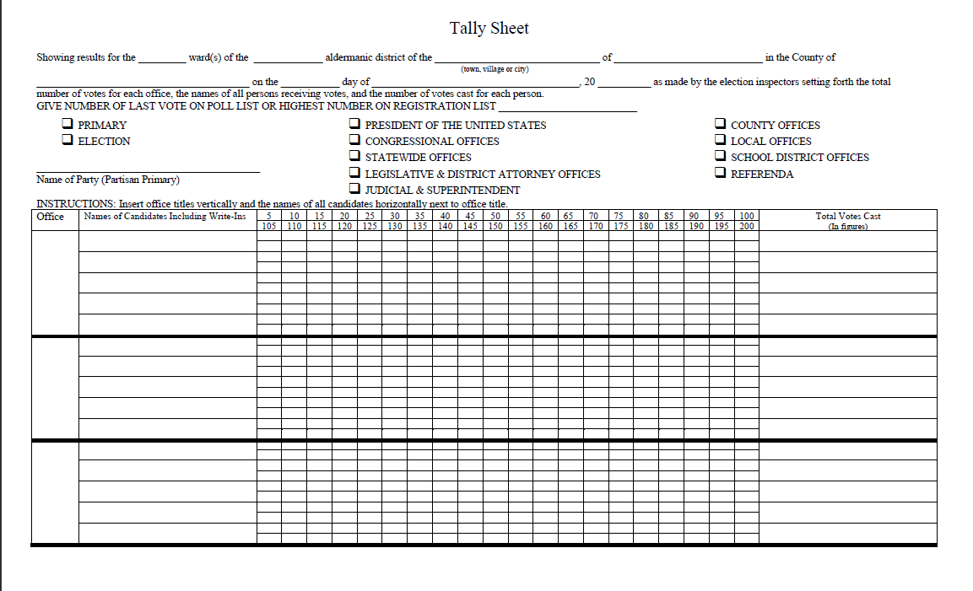
Tally Sheet (EL-106)
Notes:
Tally Sheet (EL-106)

Slide 29
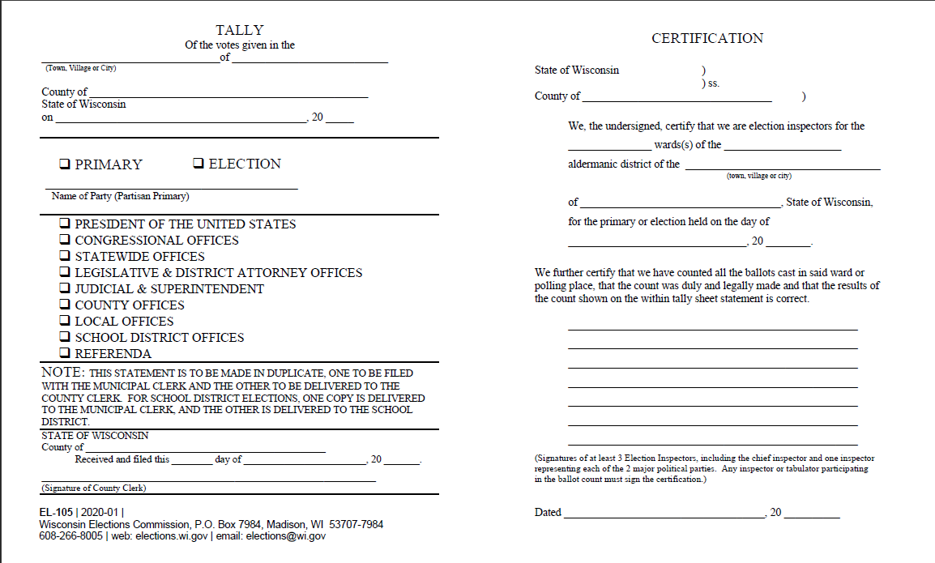
Tally Sheet (EL-106)
Notes:
Tally Sheet (EL-106)

Slide 30
Tally Sheet Exercise
State Superintendent
  Bob Smith, Mary Johnson, and Bill Roberts are all ballot candidates
  There are no registered write-in candidates
    However, someone has written in the name “Micky Mouse” on their ballot.
Town Board
  Theresa Miller, Claire Rogers, and Juan Gonzalez are all ballot candidates
  Brad Goodman is a registered write in
  Someone has written in the name “Donald Duck”
Notes:
Tally Sheet (EL-106)

Slide 31
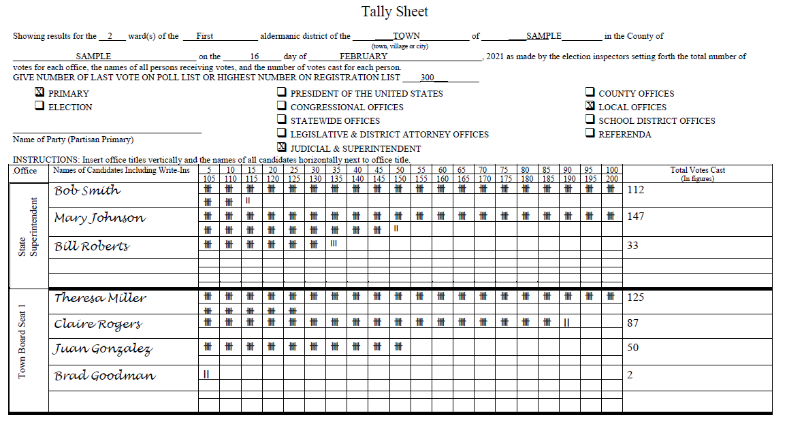
Tally Sheet Exercise
Notes:
Tally Sheet Exercise

Slide 32
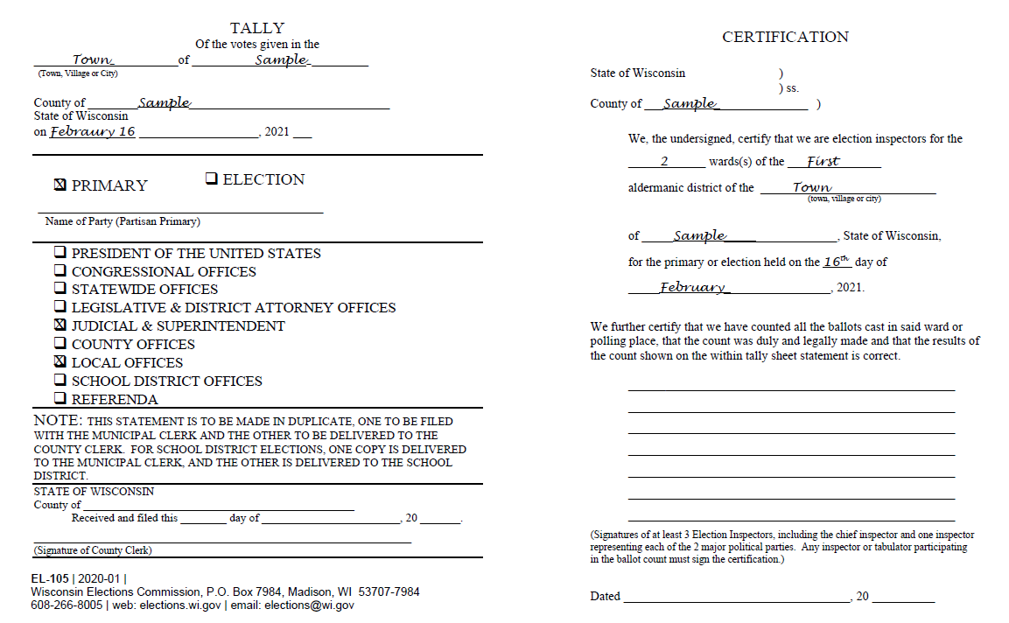
Tally Sheet Exercise
Notes:
Tally Sheet Exercise

Slide 33
WEC
Reminders
Notes:
Reminders

Slide 34
Election Day Accessibility Checklist & Quick Fix Guide
The chief inspector or clerk should review the Checklist prior to opening the polling place to ensure that it is accessible.
The Quick Fix Guide provides temporary solutions if an accessibility-related problem is identified.
Available here: https://elections.wi.gov/clerks/guidance/accessibility/polling-place-set-up
Notes:
Election Day Accessibility Checklist & Quick Fix Guide

Slide 35
Reminders
WEC
State law requires 28 days to establish residency for voting purposes.
All voters are required to submit a new absentee ballot application for 2021, except indefinitely confined voters.
Clerks may not accept absentee ballot applications in their office or a drop box before in person absentee voting starts,
Voters can return completed absentee ballots to the polling place (except central count munis),
Notes:
Reminders

Slide 36
Reminders
WEC
The address on the photo ID does not have to be current.
Absentee voters with a photo ID on file do not have to submit a new one with their new application.
If the number of ballot candidates is less than the number of votes the voter is entitled to for a contest, count all write-in votes, registered or not.
Notes:
Reminders

Slide 37
WEC
Additional Training Exercises
Notes:
Additional Training Exercises

Slide 38
Put the following steps of filling out the Inspector’s Statement in order, 1 – 5:
_____ The CI verifies the voting unit and tag numbers after the polls close on Election Day.
_____ Clerk assigns the appropriate voting
unit numbers and tag numbers at the pre- election test of the voting equipment.
_____ All election officials sign the certification
on the Inspectors’ Statement.
_____ The CI verifies the voting unit and tag numbers before the polls open on Election Day
_____ The election inspectors fill out the incident
log as necessary.
4
1
5
2
3
Notes:
Inspectors’ Statement Q and A

Slide 39
When should the chief inspector check the tamper-evident seal/tag protecting the voting equipment’s memory device?
Before the polls open on Election Day
After the polls close on Election Day
Periodically throughout the day on Election Day
All of the above
Answer: d
The chief inspector is required to check the seal or tag protecting the equipment’s memory device both before the polls open and when they close. Best practices suggest that the chief inspector also check them periodically during the day and at shift changes.
Notes:
Inspectors Statement Q and A

Slide 40
Only election inspectors still working at the polls when it closes should sign the completed certificate on the Inspectors’ Statement. True or False?
Answer: False
All election inspectors should sign the certification and indicate which hours they worked on Election Day.
Notes:
Inspectors Statement Q and A

Slide 41
Which of the following are valid forms of proof of residence if they list the voter’s full name and Wisconsin address? True or False?
Wisconsin deer hunting license
Letter from the municipal clerk
Auto insurance card
Home mortgage statement
Vehicle registration issued by the WI DOT
Credit card statement
Wedding invitation
Cell phone bill
Bank statement shown on a smart phone
Public High school report card
Mail forwarded by the post office with a yellow new address sticker attached
Letter from the Mexican Consulate
True! License issued by unit of government
True! Document issued by a unit of government
False! Issued by private company
True! Bank or Credit Union Statement
True! Document issued by u/gov’t
True! Bank or Credit Union Statement
False! Personal mail
True! Utility bill
True! POR may be shown electronically
True! Document issued by a unit of government
False! Yellow sticker not valid, but letter from the USPS is acceptable
True! Document issued by a unit of government
Notes:
POR Documents Q and A

Slide 42
Are the following statements about proof of residence documents True or False?
Acceptable proof of residence must contain the voter's current name and residential address.
Acceptable proof of residence must indicate whether a voter has resided at the address listed for at least 28 consecutive days.
Acceptable proof of residence must have an associated account number, such as a bank account number.
Proof of residence can be provided using an electronic device such as a smart phone.
There are some documents that can be used as both proof of residence and photo ID.
True! Acceptable POR must include the voter’s full name and Wisconsin address.
False! A voter certifies that they have resided at the address listed by signing the voter registration application
False! Not all acceptable forms of POR have an associated account number.
True! POR may be provided electronically using a smart phone or some other device.
True! An unexpired Wisconsin driver license or state-issued ID card, for example, can be used as POR and POI if the name and address are current.
Notes:
POR Document Q and A

Slide 43
Provisional voting may be used in the following situations, True or False?
When the voter is in the wrong polling location.
When registering, the voter is unable or unwilling to provide their unexpired WI driver license or state-issued ID card number
When the voter can’t provide proof of residence.
When the voter is unable or unwilling to provide proof of identification.
When the voter is marked “POR Required” on the poll list and is unable to provide proof of residence.
False! A provisional ballot may not be issued if the voter is in the wrong polling place.
True! A voter may cast a provisional ballot if they have been issued a WI driver license or state ID card and can’t or won’t provide the number.
False! A provisional ballot may not be issued if the voter cannot provide proof of residence at the polls on Election Day.
True! A voter may cast a provisional ballot if they can’t or won’t provide proof of identification.
Bonus question. False! This notation no longer appears on the poll list and is not a valid reason to be issued a provisional ballot.
Notes:
Provisional Voting Q and A

Slide 44
WEC
Questions?
Notes:
Questions?

