Slide 1
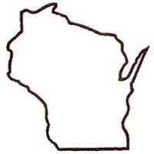
Wisconsin Elections Commission
WEC
Election Procedures:
What Election Officials
Should Know
February 24, 2021
Notes:
Election Procedures: What Election Officials Should Know

Slide 2
Agenda
Reviewing Photo ID
Remaking Ballots
UOCAVA Voters
Issuing Provisional Ballots
Reminders
Notes:
Agenda

Slide 3
Reviewing Photo ID
WEC
Both election inspectors must view the photo ID
Both inspectors should review and confirm:
The name on the photo ID conforms to the voter’s name on the poll book
It may be a variation, for example, Dick and Richard or Jones and Smith-Jones
The photo reasonably resembles the voter
The expiration date is unexpired, or if expired, meets expiration requirements
Wisconsin driver license expiration deadline extension for 60 and older voters
Notes:
Reviewing Photo ID

Slide 4
Photo ID Picture Guide
Notes:
Photo ID Picture Guide

Slide 5
Photo ID – a few tips
WEC
The Photo ID picture guide is a helpful tool, but it does not list every possible photo ID
For example, there are many varieties of military and retired military IDs. When in doubt, contact the clerk and/or the WEC before refusing to accept a military ID
Voters do not have to wear masks, but if a voter is wearing a mask and you can’t reasonably compare them to the photo ID, ask them to briefly move it
An acceptable form of photo ID does not have to list the voter’s current address
A “Real ID” with a black star is not required
No voter (except confidential voters) may be issued a ballot at the polls on Election Day without showing Photo ID
Notes:
Photo ID – a few tips

Slide 6
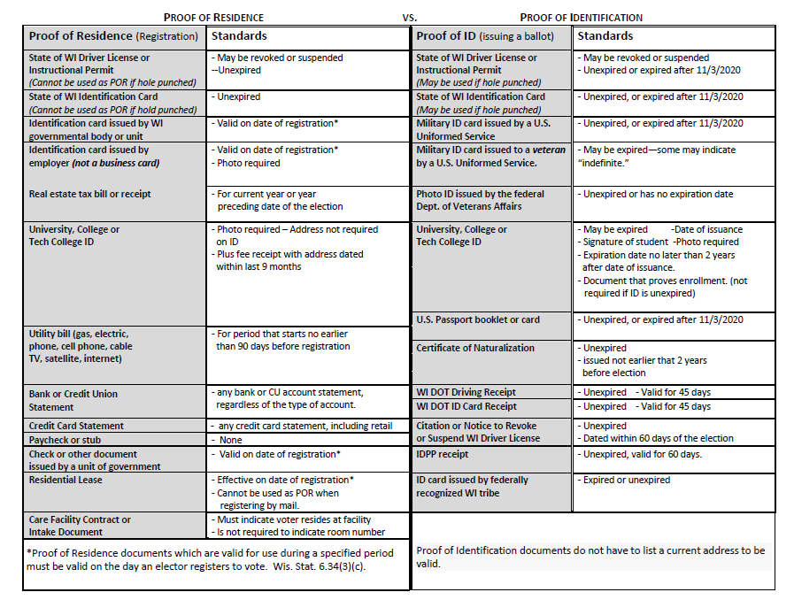
POR vs POI Standards
WEC
Notes:
POR vs POI Standards

Slide 7
Remaking Ballots
WEC
Why are ballots remade at the polls?
Absentee voter made a mistake (overvoted, crossover vote)
Voting equipment cannot “read” the ballot and it was rejected
The election inspectors can determine voter intent that is not accurately counted by the voting equipment
Example: Absentee ballots with heavy creases in write-in area; Ballots were not “true” overvotes, but were not remade
Voter marked the ballot incorrectly, for example, circled a candidate
The ballot was damaged
The ballot had been emailed to or downloaded by a military or overseas voter
Notes:
Remaking Ballots

Slide 8
Remaking Ballots
WEC
Follow the step-by-step process in the Election Day manual
Two election inspectors participate in the process
Inspectors announce that a ballot is being remade and why
Inspectors note a reason in the endorsement section of the ballot: overvoted, damaged or other
Ballots labeled original ballot #(serial number) and duplicate ballot #(serial number) – these numbers should match so both versions can be compared!
Both inspectors initial the ballots in the endorsement section
Notes:
Remaking Ballots

Slide 9
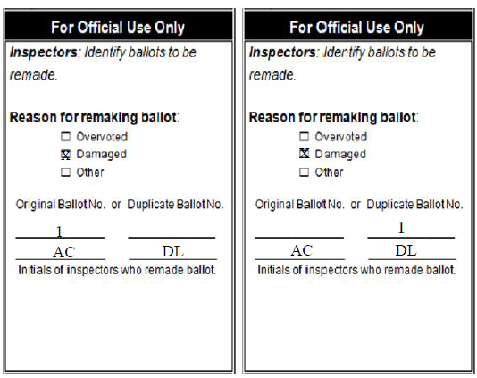
Remaking Ballots – Endorsement Section
Original
Ballot
Remade Ballot
Notes:
Remaking Ballots – Endorsement section
Remaking Ballots – Endorsement Section

Slide 10
Remaking Ballots (con’t)
Process
Inspector transfers votes based on voter intent from the original ballot to the duplicate ballot
Inspector notes on the Inspectors’ Statement why the ballot had to be remade
The remade ballots are inserted into the tabulator
The original ballots are bundled together, marked and placed in the “Original Ballots Envelope.”
The “Original Ballots Envelope” is placed in the ballot container
Notes:
Remaking Ballots

Slide 11
UOCAVA Voters: General Reminders
WEC
Ballots for spring election must be sent 21 days in advance
Military and overseas (not Indefinitely Confined) must make new requests annually
No permanent overseas ballots for spring
Military and temp. overseas may use FWAB/FPCA to register, request ballot, write-in ballot
Temporary overseas voters must provide ID
Notes:
UOCAVA Voters: General Reminders

Slide 12
UOCAVA Voters: General Reminders (con’t)
WEC
Military voters may request ballots until 5pm Friday before Election Day
Ballot delivery method and application source don’t always match
\
Military members don’t have to register or provide photo ID
Notes:
UOCAVA Voters: General Reminders

Slide 13
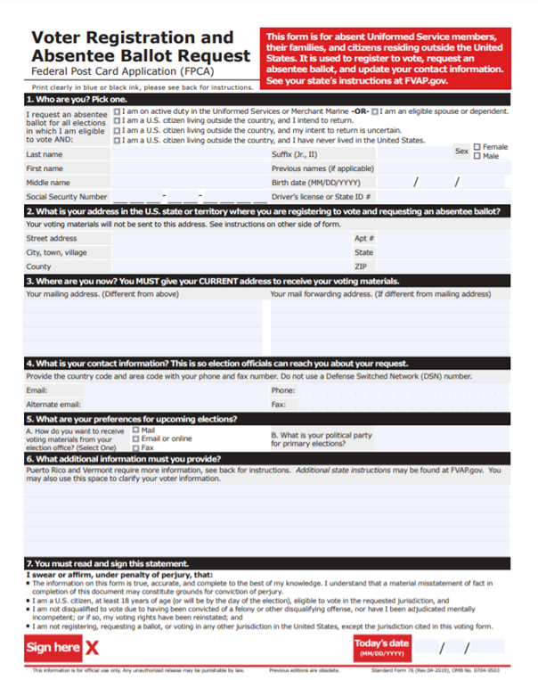
UOCAVA Voters: FPCA
WEC
Any voter may use FPCA to register or request a ballot
When used for registration, the original must be mailed
Notes:
UOCAVA Voters: FPCA

Slide 14
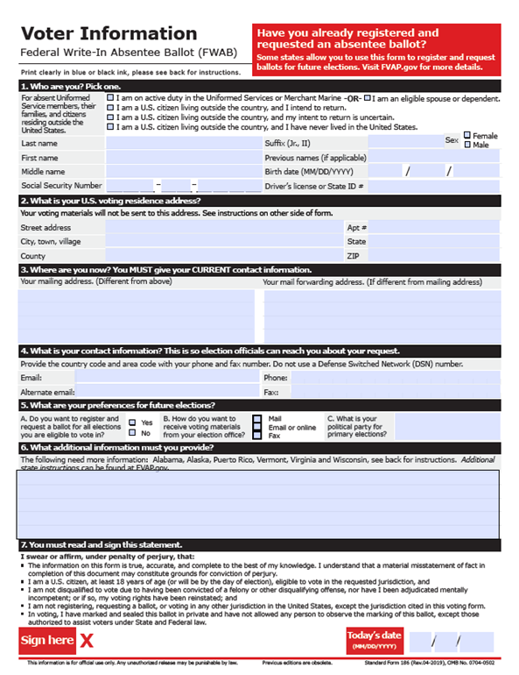
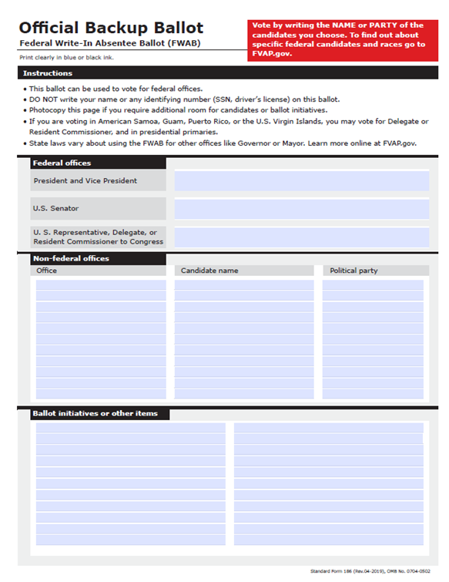
UOCAVA Voters: FWAB
WEC
Any voter may use FWAB to request a ballot
Military and Overseas voters may use it as a ballot and write in their candidate choices
If used as a ballot, the original must be signed by a witness and mailed in
Notes:
UOCAVA Voters: FWAB

Slide 15
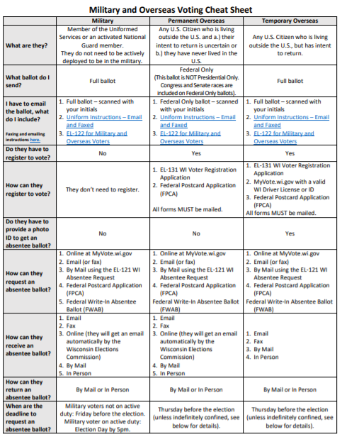
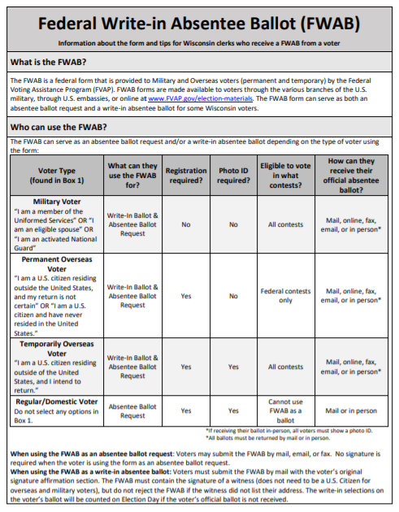
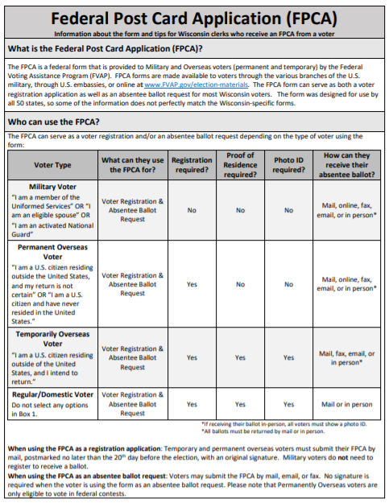
UOCAVA Voters: Tip Sheets
WEC
Search “tip sheets” on WEC website
Notes:
UOCAVA Voters: Tip Sheets

Slide 16
Issuing Provisional Ballots
WEC
Follow the step-by-step process in the Election Day manual.
When are provisional ballots required to be offered to voters?
A voter who has been issued a WI driver license or state ID card and is unable or unwilling to provide the number.
A voter who is unable or unwilling to provide photo ID.
When are provisional ballots not offered to voters?
A voter who does not have acceptable proof of residence.
A voter in the wrong polling place.
Notes:
Issuing Provisional Ballots

Slide 17
Issuing Provisional Ballots (con’t)
WEC
Can the election inspectors suggest the voter bring the missing information back to the polling place?
Yes, but the voter should be informed of all their options, including returning the missing information to the clerk’s office by 4 pm the Friday following the election.
IDPP information should be available for voters who need to get a photo ID.
Are the number of outstanding provisional ballots posted on the clerk’s website election night?
Yes, state law requires the number to be posted.
Notes:
Issuing Provisional Ballots

Slide 18
Reminders
WEC
Clerks may send out by mail absentee ballots when ballots are available.
By mail absentee ballot requests may not be delivered by a voter in the clerk’s office or a drop box before the start of in person absentee voting.
In person absentee voting in the clerk’s office may not begin any earlier than 14 days before an election or March 23, 2021.
Clerks who issued in person absentee ballots prior to that date must contact the voter to let them know it will not be honored.
Notes:
Reminders

Slide 19
Reminders
WEC
Absentee ballots voted or returned to the clerk’s office or the polling place should be clearly secured.
Voters may request calendar year absentee ballots on the MyVote WI website through 5 pm the Friday before the election.
The use of Special Voting Deputies for the April election will be discussed at the March 2 Commission meeting.
Notes:
Reminders

Slide 20
WEC
Questions?
Notes:
Questions?

